Slide 1
CIN updates! :D Gettin’ fit
3/9/2016

Slide 2
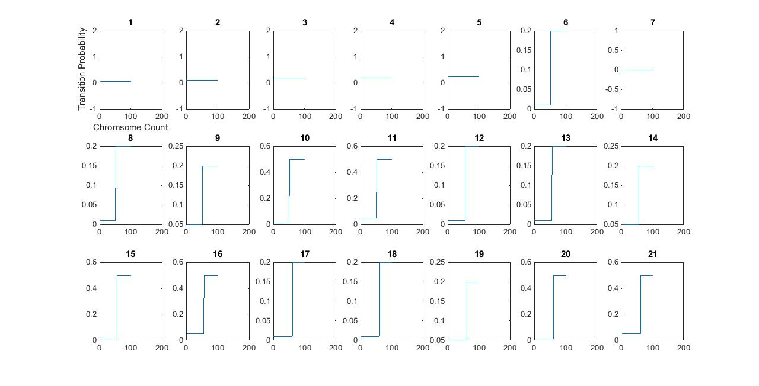
Parameters for 1 missegregation event

Slide 3
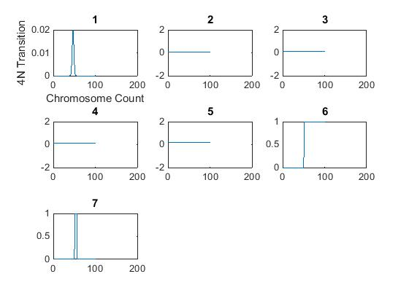
Parameters for 1 missegregation event

Slide 4
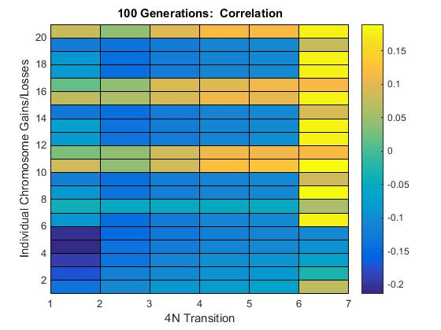
100 Generations - Traditional

Slide 5
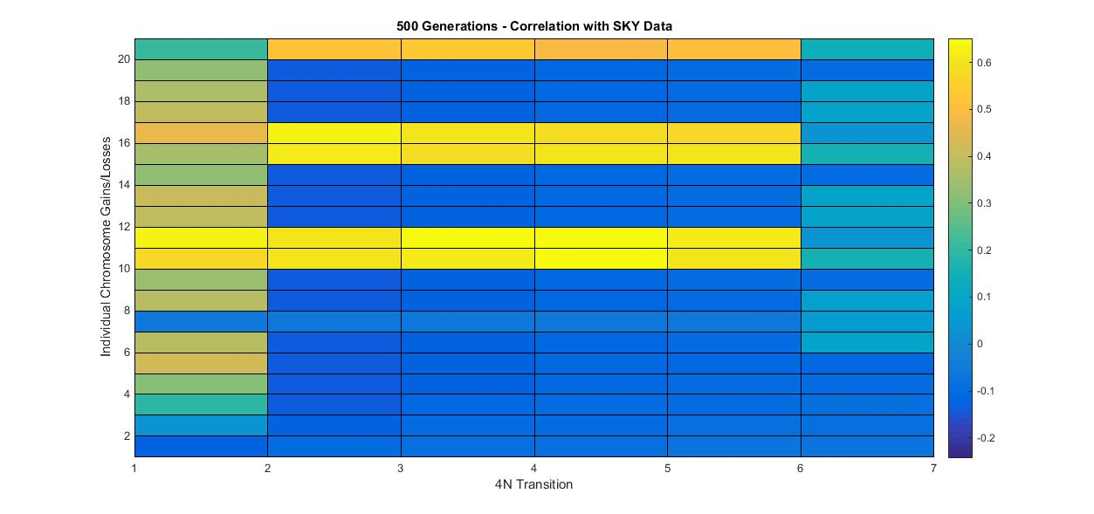
500 Generations – Traditional

Slide 6
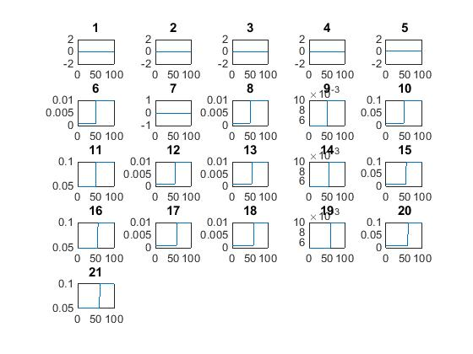
Binomial distribution parameters

Slide 7
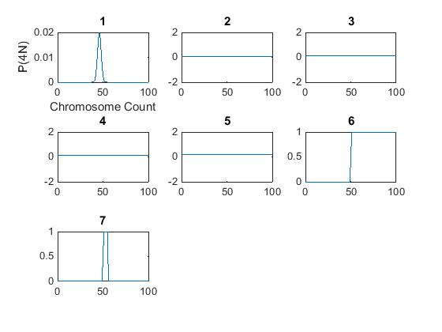
Binomial distribution parameters

Slide 8
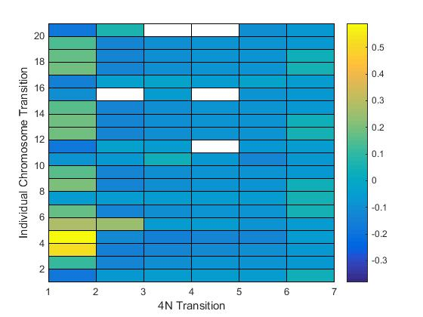

Slide 9
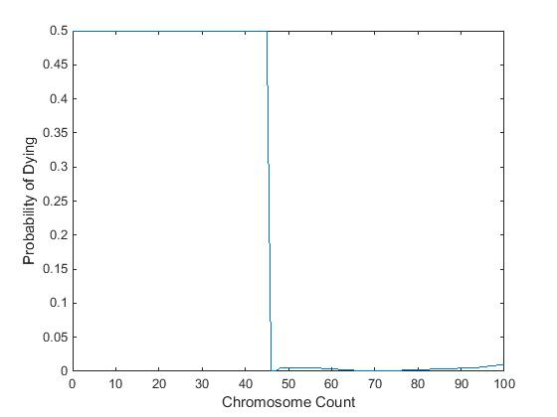
Incorporating fitness

Slide 10
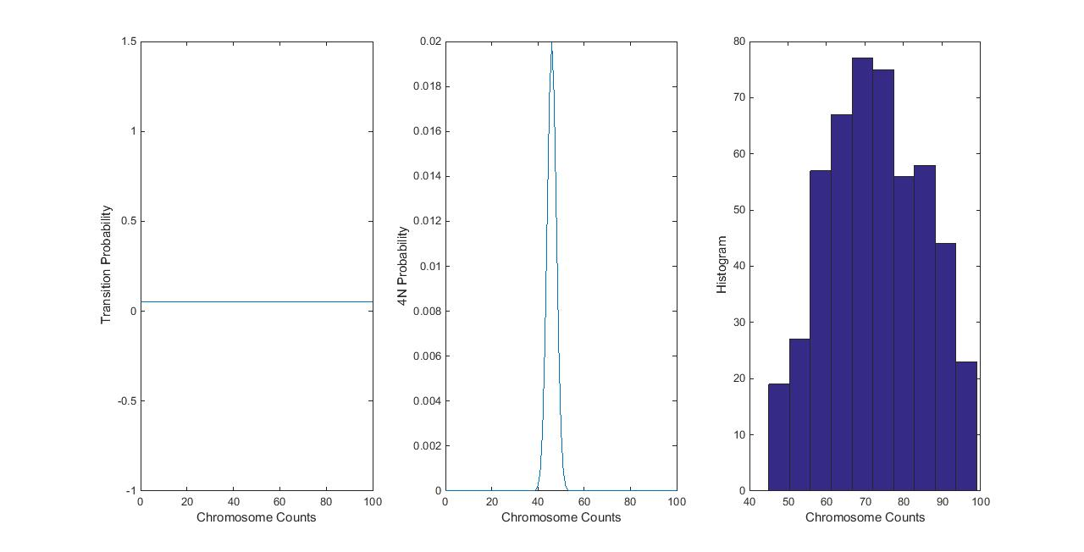
Distribution at 500 generations

